Slide 1

Hollywood's Most Profitable Stories Case Study
Group 4
Batch – April 2024
Notes:
In this presentation, we will start with identifying the types of variables present, and then move on to data analysis and visualization. We will use various data visualization techniques to gain insights and answers from the data. By the end of this presentation, you should have a better understanding of the data and be able to make informed decisions based on the insights gained.

Slide 2

Agenda
Problem Statement
Introduction and Team
Data Overview
Analysis and Visualization
Insights and Answers

Slide 3
Problem Statement:
The goal of this analysis is to explore Hollywood's most profitable movies through data visualization techniques. The analysis aims to identify key trends and insights related to movie genres, revenue generation, and profitability ratios. Key tasks include determining the most profitable genres, assessing earnings trends over time, and calculating gross revenues and profitability for specific genres like comedy and action. The insights gained from this analysis will provide a deeper understanding of the factors that contribute to box office success and guide future movie production strategies.

Slide 4
Introduction and Team

Slide 5





Team Members
Sishira Mishra
Gopinatha Tejasvi G M
Girish Chandra Mundadi
Lokesh G
Ashly P Eldho

Slide 6
Data Overview

Slide 7
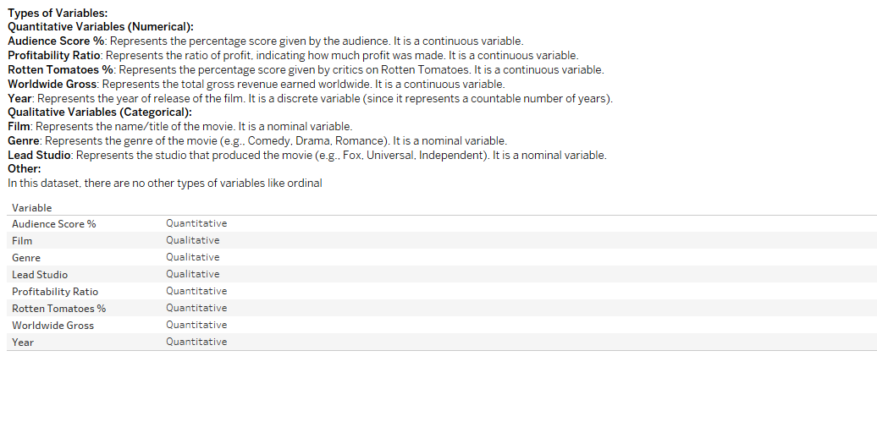
Identify the types of variables present

Slide 8
Data Analysis and Visualization

Slide 9
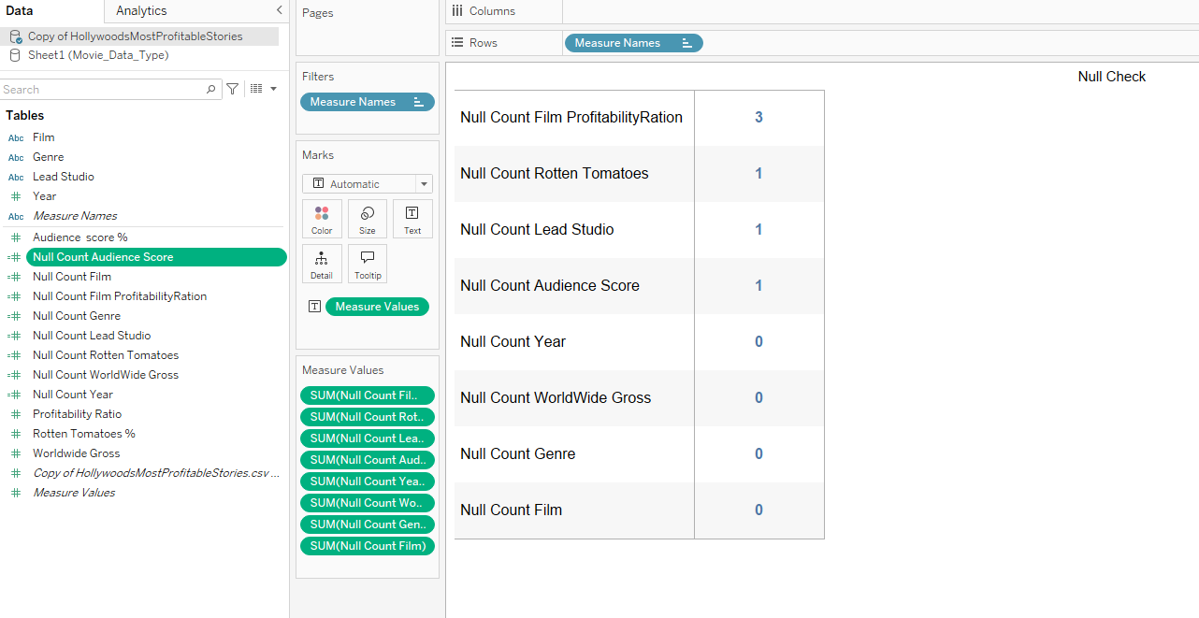
Which variable has null values How many null values does Tableau identify in this complete dataset
Summary:
Profitability has 3 Null value
Rotten Tomatoes, lead Studio, Audience Score has 1 Null value each
All other has no Null value

Slide 10
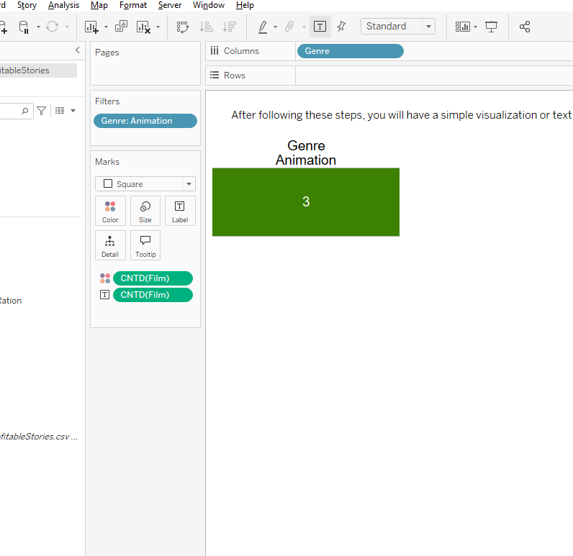
Identify total number of movies in animation genre
Insights:
Total number of movies in the "Animation" genre, which is 3 based on your dataset.

Slide 11
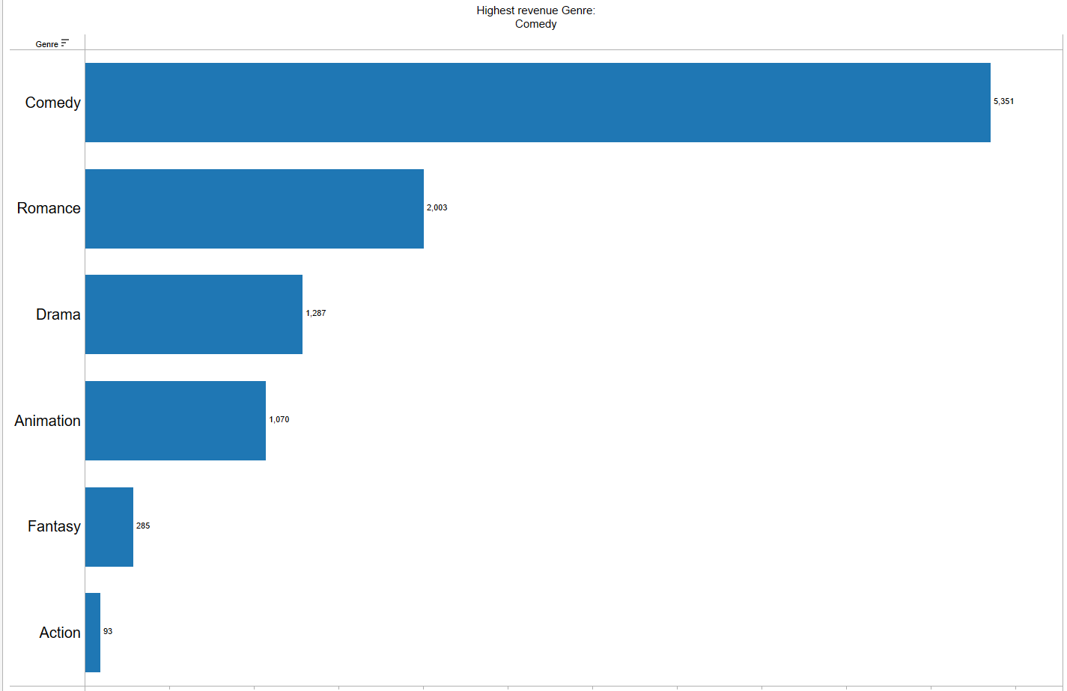
Prepare a bar graph and identify highest revenue generating genre
Insights:
Highest revenue Genre: Comedy

Slide 12
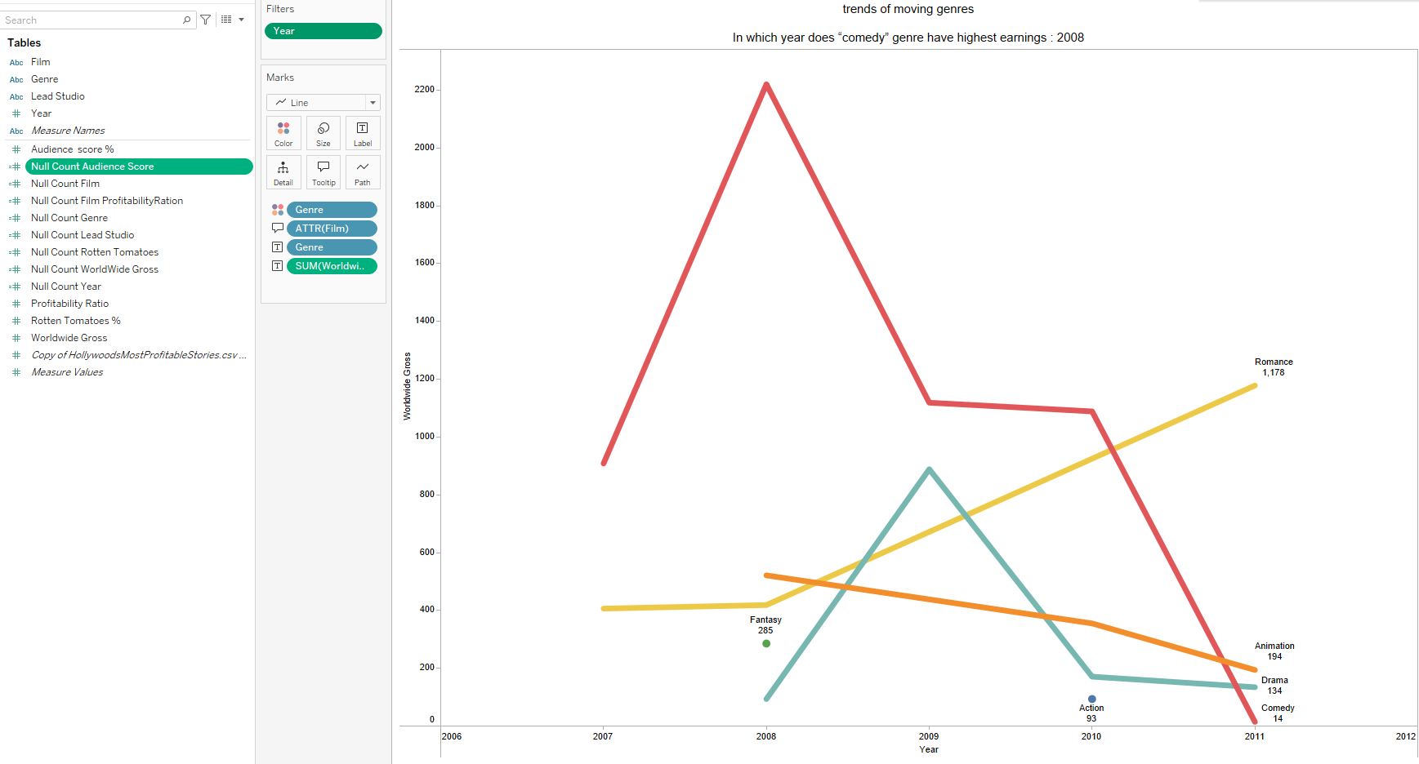
Plot a line graph with earnings trends of moving genres from year 2007 to 2011

Slide 13
Insights and Answers

Slide 14
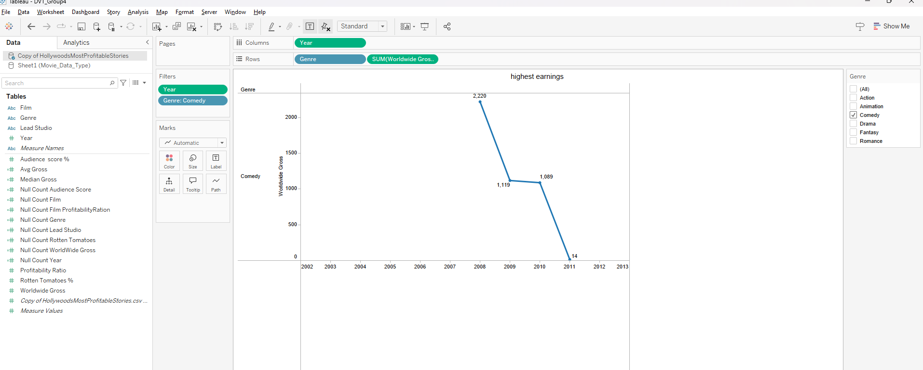
Question 1 | Answer
In which year does “comedy” genre have highest earnings | 2008 is the where Comedy Genre had a highest profit

Slide 15
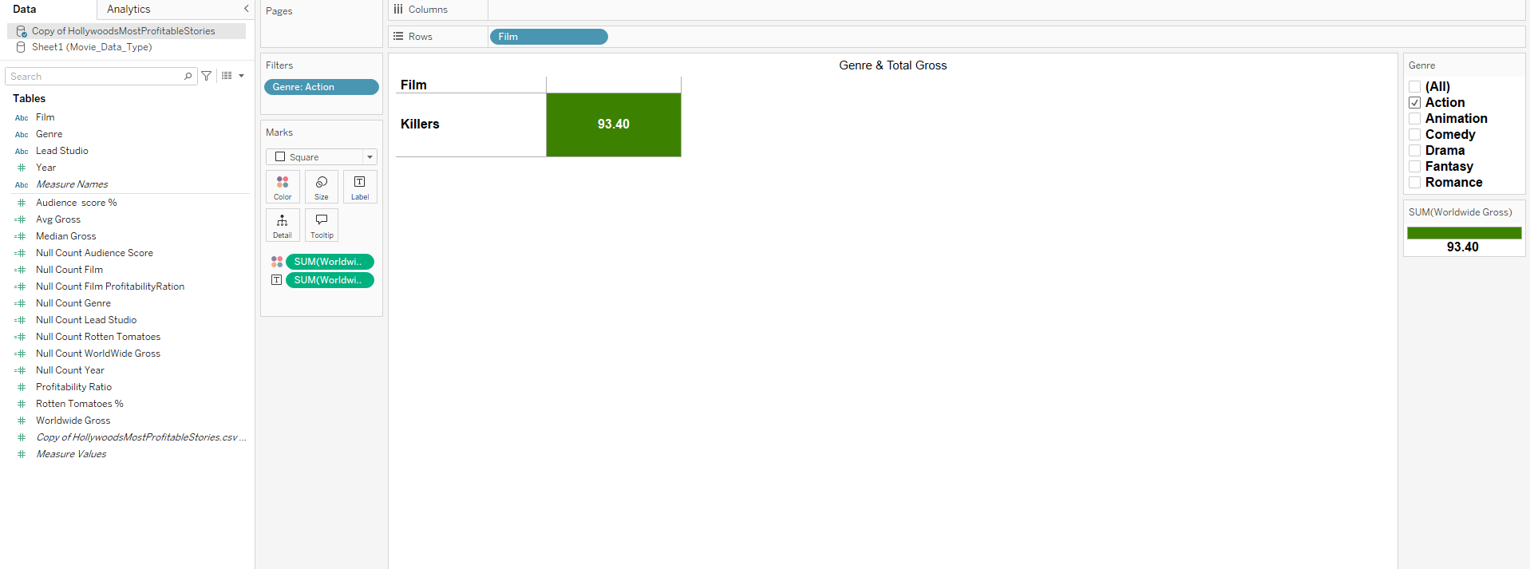
Question 2 | Answer
Which movie is highest grosser in “action” genre | Killers is the move having highest Gross in “action”. This is also only one move in our dataset for Action Genre.

Slide 16
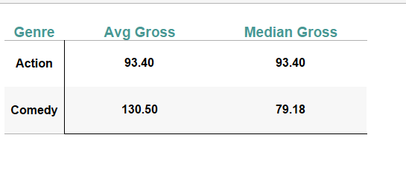
Question 3 | Answer
What are average & median gross revenues of movies in “comedy” and “action” | Comedy: Avg Gross: 130.50 Median Gross: 79.18 Action: Avg Gross: 93.40 Median Gross: 93.40

Slide 17
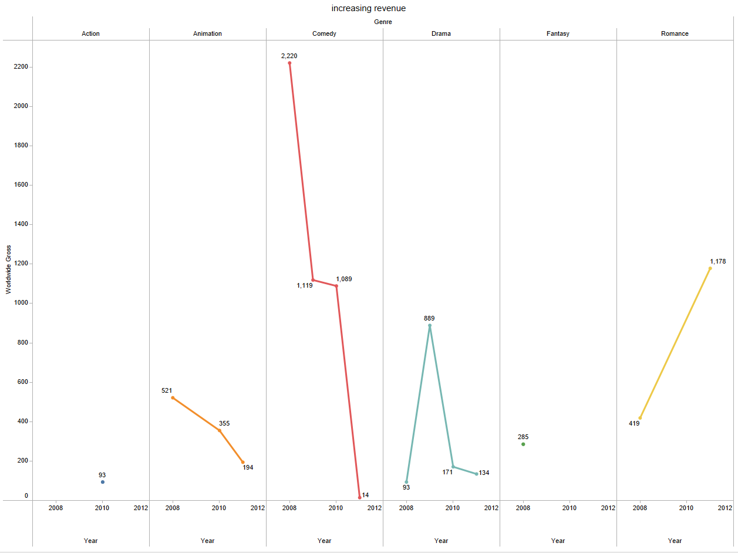
Question 4 | Answer
Which movie genre had an increasing revenue from year 2008 - 2011 | Romance movie is having increasing revenue trend from 2008 - 2011

Slide 18
Thank You

